Slide 1

Commercial & Sustainable Agriculture Business Models
Cape Town, 4 December 2014
By Jesmane Boggenpoel
Head of Business Engagement Africa, WEF

Slide 2
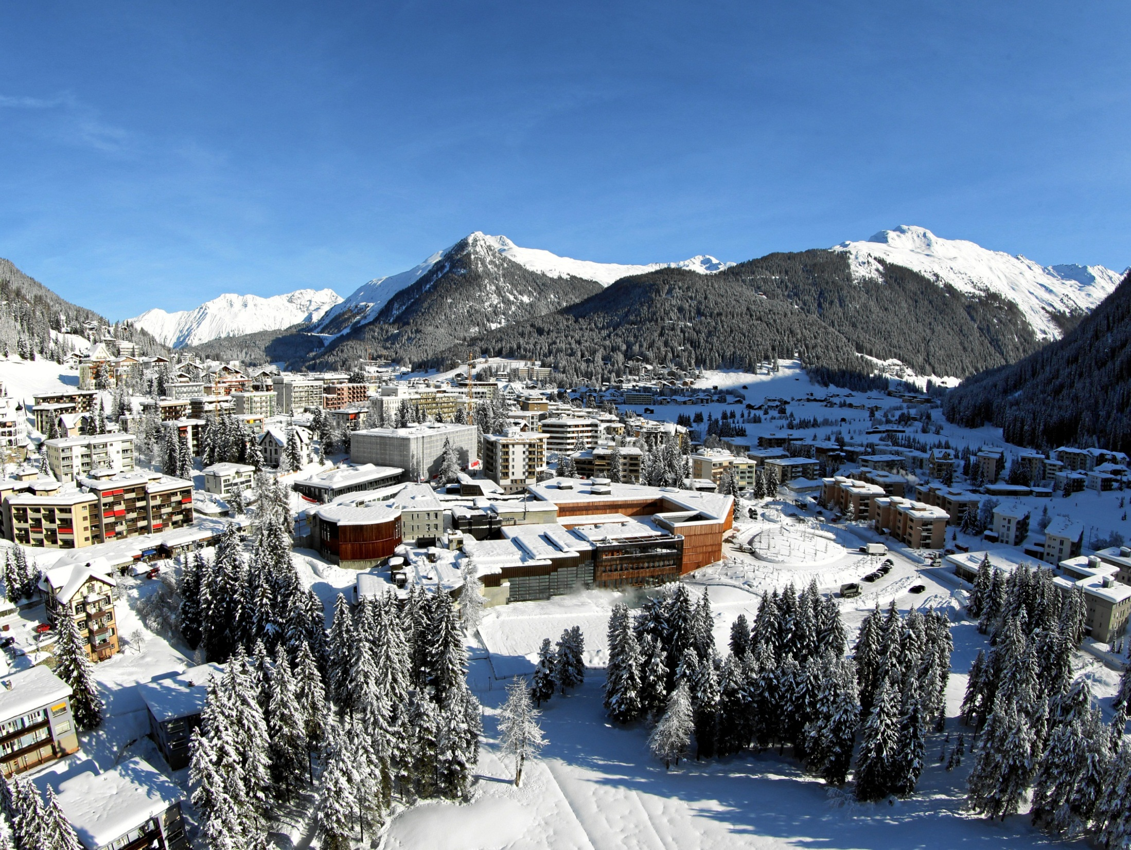
Agenda
Introduction
World Food Programme
Flour Mills of Nigeria/Thai Farms
Better Trading Company (Cape Town)

Slide 3
Agenda
Introduction

Slide 4

Introduction
Private equity and corporate finance (CA) SA
Boards of Land Bank & Senwes, Afdb advisory, Course-work (Harvard HKS MPA)
Co-founded by AU, Nepad and WEF
Active in ten countries and three more on board
Over $10bn of committed investments from over 200 countries
Experience
WEF Grow Africa
4

Slide 5
Introduction
Development
Skills (example: Buhler Africa Milling School)
Giving locals the chance to develop and to be included in the value-chain
Focus of Talk
5

Slide 6
Agenda
Introduction
World Food Programme

Slide 7

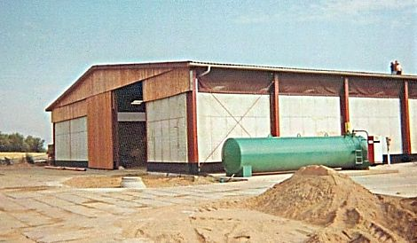
World Food Programme
Sourcing raw materials (eg grain) from rural farmers where possible instead of importing
Cause of food shortage: high perishables due to lack of storage
Solution : Set up food warehouse in Uganda with 3 keyholes (to build trust amongst villages) – funded by Japan (JICA). This broke decades of food aid.
Buying raw materials locally
Solutions based on deep insight on problem
7

Slide 8
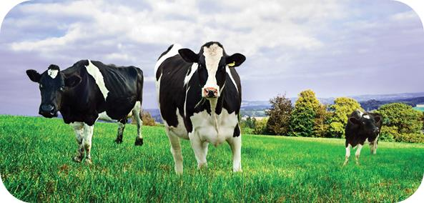
World Food Programme
Dairy industry flourished when procurement moved from traditional food aid to local procurement
40% of food aid delivered by swipe cards or cell phones. Every recipient of food got a card and there are screens to monitor who is buying food.
Shop owners, local dairy and milk producers grew significantly.
Developing West Bank Gaza Diary Industry
8

Slide 9
Agenda
Introduction
World Food Programme
Flour Mills of Nigeria/Thai Farms

Slide 10
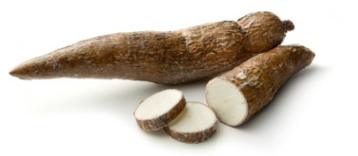
Thai Farms
170m people - 70% (100m) poor
Staple diet import dependent - wheat (4m tons pa), rice (over 1m tons pa).
Abundant arable land yet world’s largest food importer
Tuber demand potentially Naira bn
Nigerian government surporting cassava – 1 of 5 focus crops
Drivers
10

Slide 11

Transform sector from peasant to commercial farmers
Started in 2006. Acquired by Flour Mills of Nigeria in 2012
High quality staple food
Starch content above 70%
Thai Farms
Salient
Features
11

Slide 12
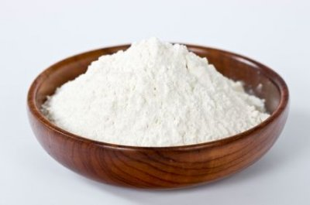





Despite dominating global cassava production, Nigeria has yet to benefit from cassava's many uses
4_85
Nigeria is the largest global cassava producer…
…but Many end markets remain untapped
Traditional food (~90% of current Nigerian cassava use)
Industrial uses (~10% of current Nigerian cassava use)
Nigeria represents 20% of global production
Cassava flour
Dried chips
Sweeteners
Ethanol
Beer
Starch
Source: FAOSTAT; Action plan for cassava in Nigeria (2011)

Slide 13
Current organization of farm-to-processor logistics presents multiple challenges
21_89
Current logistical arrangement
Challenges to efficient supply
Commercial farm
Commercial farm
High transport costs
Transport risk often assumed by farmer
Unreliable buyer / pricing
Bulk harvesting challenges
Competition from local markets
Small-holder farm
Small-holder farm
Small-holder farm
Small-holder farm
Small-holder farm
Small-holder farm
Processor
Source: Interviews with experts, processors and producers, PIND Cassava value chain analysis

Slide 14
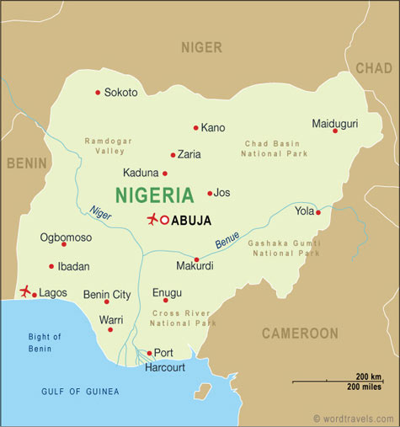
Cassava’s low value-to-volume ratio means that long transport distances are not economical
4_85
Transport costs are high
relative to production costs…
…so Supply is limited to a ~200km radius of the processor
Processors pay for starch content (~20% of tuber volume)
The remaining ~80% of fresh root volume is waste (water and fiber)
Transporting these bulky waste materials is expensive
60km radius, avg. load size 2mt; ~30% of volumes
200km radius, avg. load size 7mt; ~90% of volumes
2x
Thai Farms
Source: Expert interviews

Slide 15
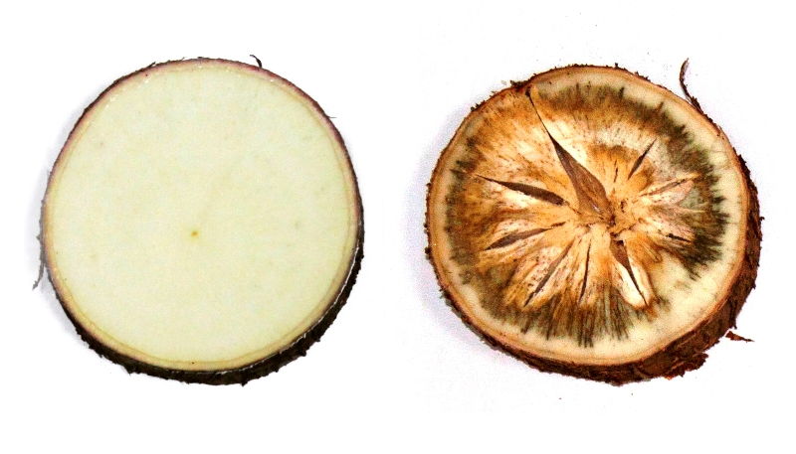
Cassava’s perishability also contributes to high transport costs, sometimes resulting in physical losses
23_89
Cassava roots lose value quickly after extraction…
…resulting in additional costs
Farmer income decreases due to post-harvest delays
Trucks often wait ~2 days while harvesting is carried out
One truckload in twelve perishes completely due to breakdowns or accidents
Transportation is more expensive because farmers are under pressure
Starch content decreases over time; after 72 hours, unusable due to cyanide build-up
Physical losses occur
Note: Value decrease is approximate; depends on initial starch content and atmospheric conditions
Source: Thai Farms field trials; Expert interviews

Slide 16
Due to these challenges, farmers cannot find buyers while processors operate well below capacity. Half of 2009 crop was un-harvested and factories at 25 -50% capacity Two solutions exist to locate production closer to processing, led by private investment
83_84
Existing processors: bulking/primary processing points
New processors:
Nucleus farm and cluster models
Out-grower farm
Out-grower farm
Out-grower farm
Out-grower farm
Out-grower farm
Out-grower farm
Out-grower farm
Out-grower farm
Bulking point
Out-grower farm
Nucleus farm
Optional: Primary processor
Processor
Processor
Both solutions are currently being piloted by Thai Farms

Slide 17
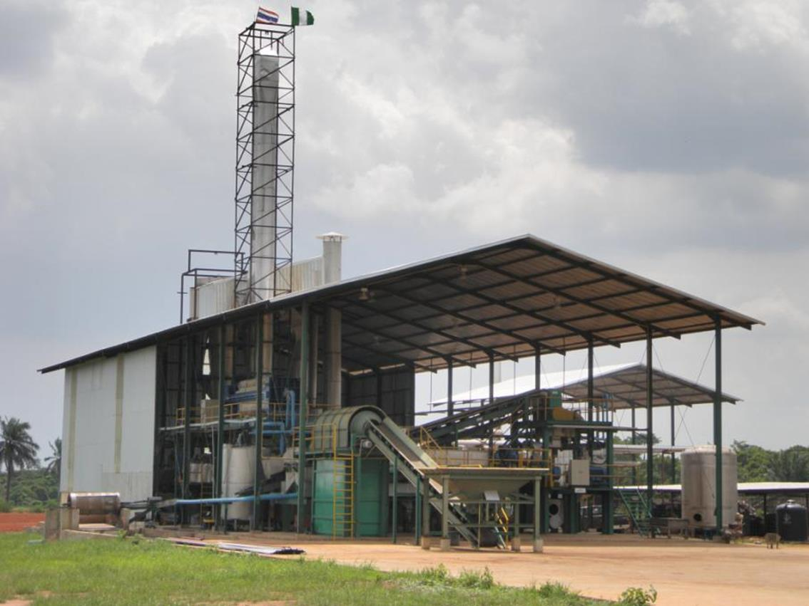
Thai Farms
Factory staff of 90
Farmer community of 2,000
New coal mines in Kogi and Edo states
Community Impact
17

Slide 18
Agenda
Introduction
World Food Programme
Flour Mills of Nigeria/Thai Farms
Better Trading Company (Cape Town)

Slide 19

Investor : Shell Foundation, offices CT, London, Harare
Agriculture investment holding company
Undertakes TA
Market access, product development, feasibility study
Southern & Eastern Africa
19

Slide 20

Chilly Project in Zimbabwe
Partnership with Elephant Pepper Company
Export Tabasco Chillies in Zimbabwe
Train project launched mid-2009
Over 200 small-holder farmers planting
20

Slide 21
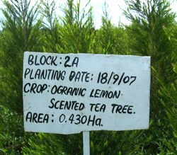
Tea Tree Oil Project in Kenya
Operated by Earthoil
400 small-scale farmers producing
tea tree crop
Finance, supervision and mentoring
Oils sold to The Body Shop
21

Slide 22
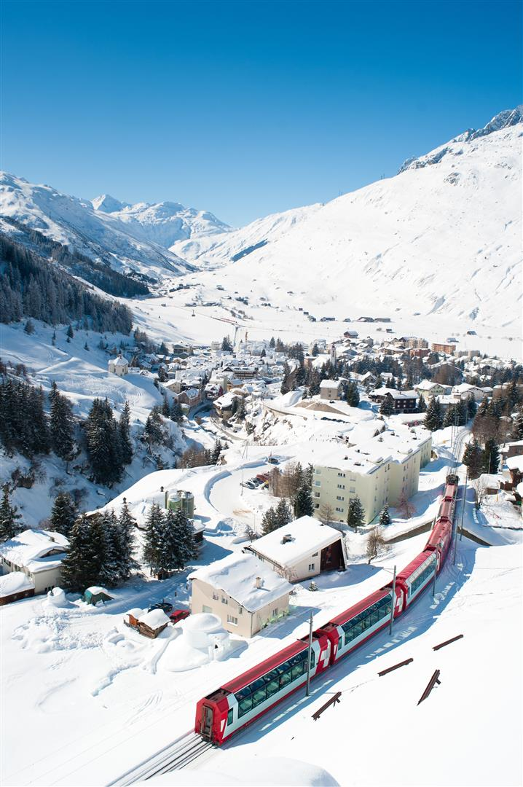
Thank You

